Slide 1


INTO University Partnership Expansion
Sravanthi Devalpalli
April 2023
Notes:
NOTE:
To change the image on this slide, select the picture and delete it. Then click the Pictures icon in the placeholder to insert your own image.

Slide 2
Business Objective
To identify the potential universities/colleges in the United States for the expansion of INTO University Partnerships portfolio.
The universities must be in a state:
Which is proven to be highly attractive to international students.
Where INTO does not currently have a university partner.
With a relatively affordable price point for undergraduate study.

Slide 3
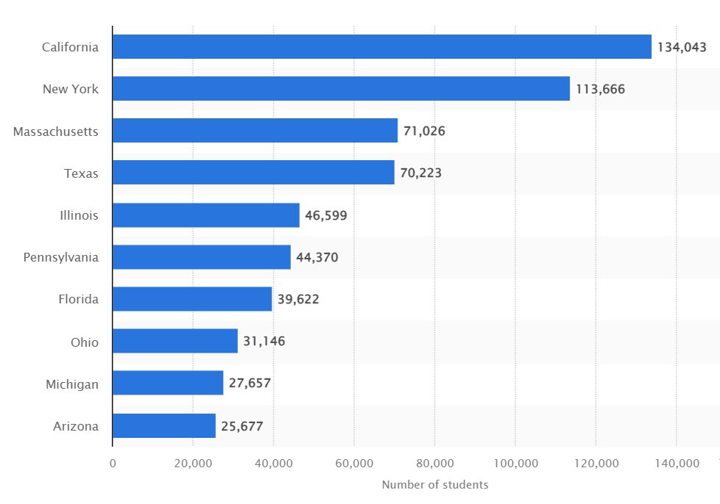
U.S. states hosting the most international students in the academic year 2021/22
(source: https://www.statista.com)

Slide 4
What was the approach?
Location
Large City
Midsize City
Small City
Large Suburb
Midsize Suburb
Small Suburb
Town Fringe
Top 50 Universities
Highest number of International Students from 2017 – 2020.
Compared percentage of International Students with State Benchmark
Top 20
Universities
Based on affordability
Top 5
Universities
Excluding the states where INTO currently has a university partner.
Top 10 States
California
New York
Massachusetts
Texas
Illinois
Pennsylvania
Florida
Ohio
Michigan
Arizona
Source for State Benchmark: https://www.applyboard.com

Slide 5
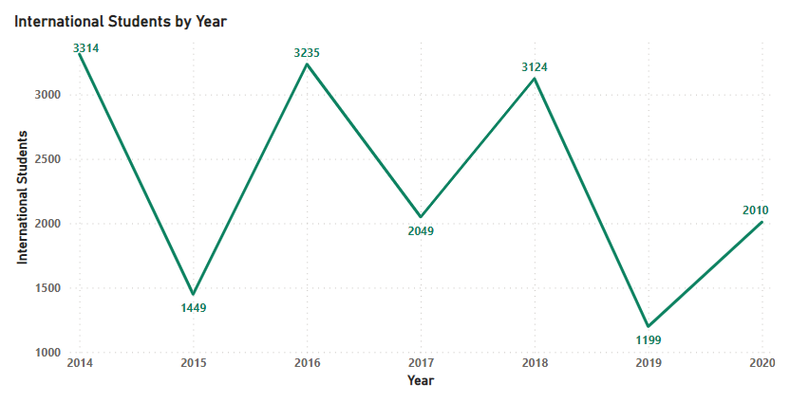
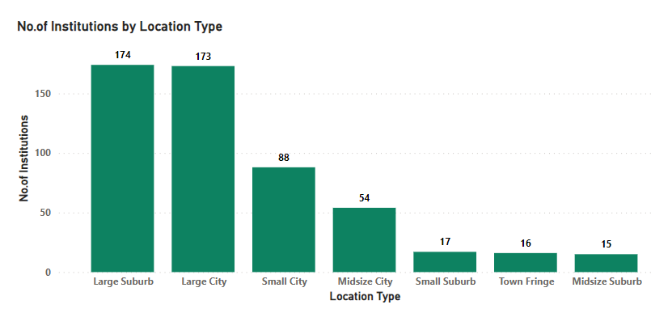
Insights for the period (2014 – 2020)

Slide 6
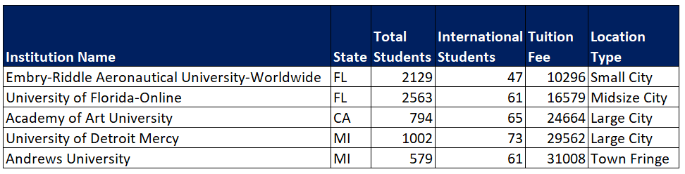
These Top 5 Universities could create an impact

Slide 7

Thank You
Dashboard Link
https://app.powerbi.com/groups/me/reports/57d9e034-b1ca-42e2-b953-a9d3b6fd0015/ReportSection6cc52752e0c25c8aaaa3

